Slide 1
Outline
1. Splay tree
2. Fibonacci heap

Slide 2
1.Splay tree
A splay tree is a self-adjusting binary search tree with the additional property that recently accessed elements are quick to access again.[Wikipedia]
[Source from Wikipedia]

Slide 3
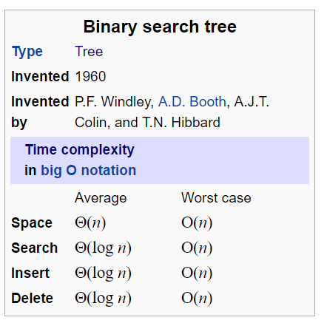
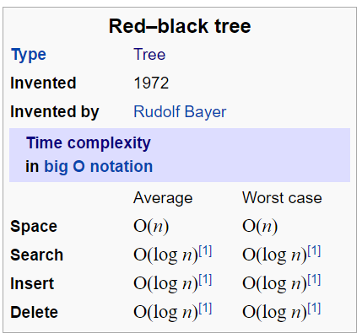
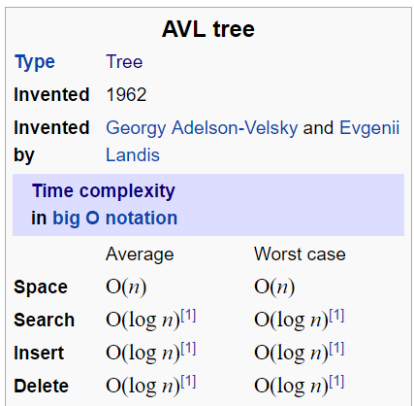
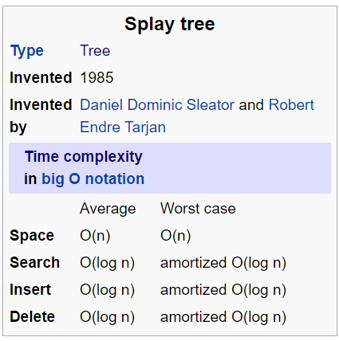
Recently accessed elements are quick!
[Source from Wikipedia]

Slide 4
Major operation
Splay()->
Move recently
accessed element up
[Top down approach]

Slide 5
Case 1: Zig
L
X
R
L
R
Y
X
Y
XR
YL
Yr
XR
YL
Yr
If Y should become root, then X and its right subtree are made left children of the smallest value in R, and Y is made root of “center” tree
[Source from https://www.csee.umbc.edu/courses/undergraduate/CMSC341/fall02/Lectures/Splay/TopDownSplay.ppt]

Slide 6
Case 2: Zig-Zig
L
X
R
L
R
Z
Y
XR
Y
Z
ZL
Zr
X
YR
YR
XR
ZL
Zr
The value to be splayed is in the tree rooted at Z. Rotate Y about X and attach as left child of smallest value in R
[Source from https://www.csee.umbc.edu/courses/undergraduate/CMSC341/fall02/Lectures/Splay/TopDownSplay.ppt]

Slide 7
Case 3: Zig-Zag(Simplified)
R
L
X
R
L
Y
X
Y
XR
YL
Z
XR
YL
Z
ZL
Zr
ZL
Zr
The value to be splayed is in the tree rooted at Z. To make code simpler, the Zig-Zag rotation is reduced to a single Zig. This results in more iterations in the splay process.
[Source from https://www.csee.umbc.edu/courses/undergraduate/CMSC341/fall02/Lectures/Splay/TopDownSplay.ppt]

Slide 8
Reassembling the Splay Tree
L
R
X
X
L
R
XL
XR
XL
XR
When the value to be splayed to the root is at the root of the “center” tree, we have reached the point where we are ready to reassemble the tree. This is accomplished by a) making XL the right child of the maximum element in L, b) making XR the left child of the minimum element in R, and then making L and R the left and right children of X
[Source from https://www.csee.umbc.edu/courses/undergraduate/CMSC341/fall02/Lectures/Splay/TopDownSplay.ppt]

Slide 9
API
// Constructs an empty tree.
SplayTree();
// Constructs a tree containing the given elements.
SplayTree(std::initializer_list<T>);
// Is this tree empty?
bool empty() const;
// Returns the number of elements in the tree.
size_t size() const;

Slide 10
API
// Test whether the tree contain the given value.
bool contains(const T &);
//Return root value.
T root_value() const;
//Return the max value.
T max() const;
//Return the min value.
T min() const;

Slide 11
API
//If item i is in tree, return a pointer to its location;
//otherwise, throws an exception.
const T &access(const T &);
// Inserts an element into the tree, if absent.
void insert(const T &);
// Removes an element from the tree, if present.
void remove(const T &);

Slide 12
API
//Combine two trees in one tree.
//This operation assumes that all items in current tree are less than all those in other and destroys t2.
void join(SplayTree &) noexcept;
//Return a vector contains the pointer of two trees
std::pair<SplayTree<T>, SplayTree<T>> split(const T &);

Slide 13
IMPLEMENTATION
private: struct node_; using ptr_ = std::unique_ptr<node_>; using lot_ = std::vector<SplayTree>; ptr_ root_; size_t size_; bool bounded(node_ *node, T lo, bool lo_inf, T hi, bool hi_inf); int count_element() const; static int count_element_ptr(const ptr_ &); static T max_ptr(const ptr_ &); static T min_ptr(const ptr_ &); void splay_(const T &key); };

Slide 14
2. Fibonacci heap
A Fibonacci heap is a data structure for priority queue operations, consisting of a collection of heap-ordered trees.
[Source from Wikipedia]

Slide 15
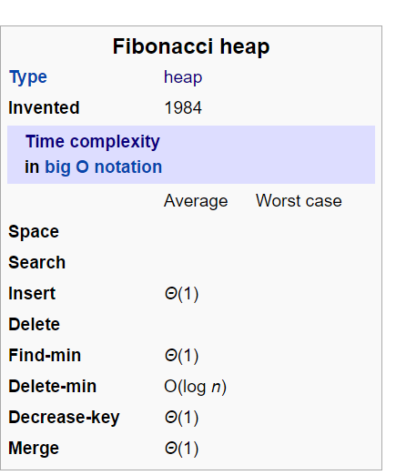
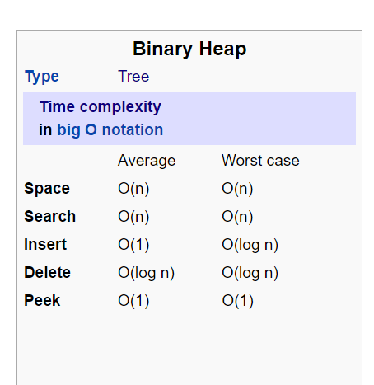
[Source from Wikipedia]

Slide 16


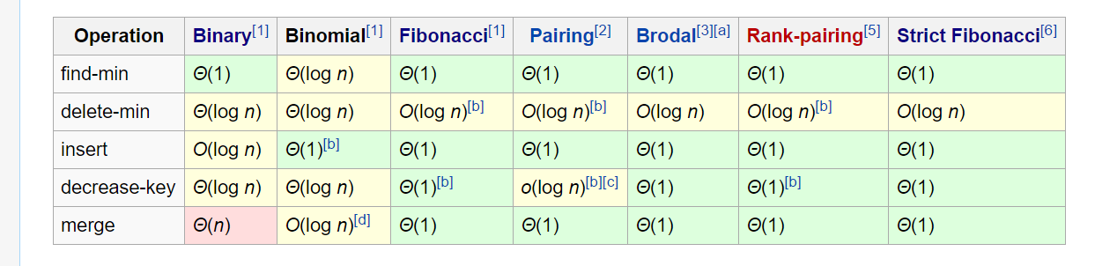
Fibonacci heap has a better amortized running time!
[Source from Wikipedia]

Slide 17
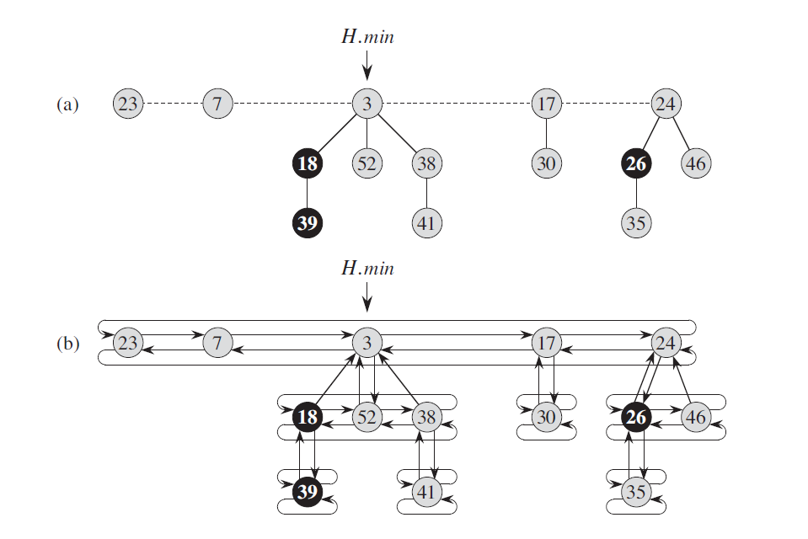
[Cormen, T. H. (2009). Introduction to algorithms. MIT press.]

Slide 18
Major operation
consolidate()->
Merge sub-heaps

Slide 19
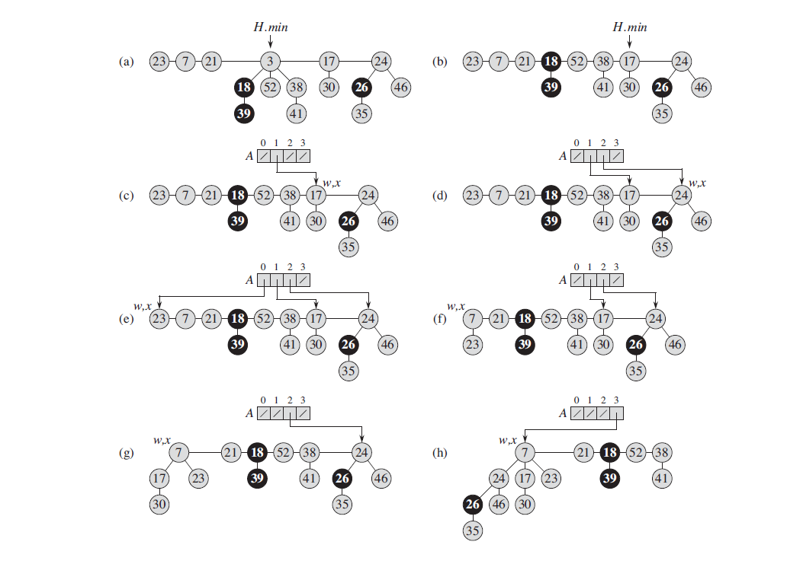
Delete operation
[Cormen, T. H. (2009). Introduction to algorithms. MIT press.]

Slide 20
[Cormen, T. H. (2009). Introduction to algorithms. MIT press.]

Slide 21
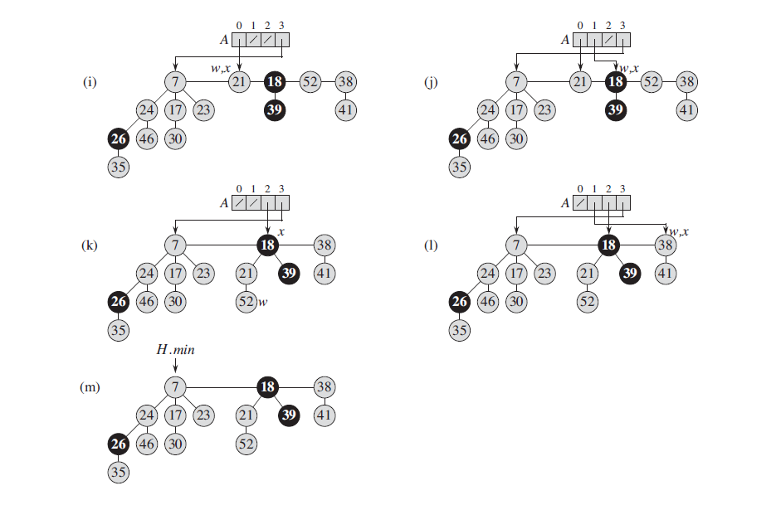
[Cormen, T. H. (2009). Introduction to algorithms. MIT press.]

Slide 22
API
// Constructs a new, empty Fibonacci Heap.
FibonacciHeap() noexcept;
// Constructs a new Fibonacci Heap with only one element;
FibonacciHeap(const T &);
// Constructs a new Fibonacci Heap with the given elements;
FibonacciHeap(std::initializer_list<T>);
// Move constructor.
FibonacciHeap(FibonacciHeap &&) noexcept;

Slide 23
API
// Move assignment operator.
FibonacciHeap &operator=(FibonacciHeap &&) noexcept;
// Returns true if the deque is empty.
bool empty() const noexcept;
// Returns the number of elements in the deque.
size_t size() const noexcept;
// Inserts a new element in the Fibonacci Heap
void insert(const T &);
void insert(T &&);

Slide 24
API
// Returns a reference to the minimum element of the Fibonacci Heap . If the Fibonacci Heap is
// empty then the behavior is undefined.
const T &minimum() const;
T &minimum();
// Constructs a new element in the Fibonacci Heap
template<typename... Args>
void emplace(Args &&...);
// Deletes the element from Fibonacci Heap whose key is minimum,
// returning a pointer to the element. Undefined if the deque is empty.
const T &extract_min();

Slide 25
API
//Delete the minimum element.
void remove_min();
//Union two Fibonacci Heap without copying.
void merge(FibonacciHeap &) noexcept;
// Removes all elements from the Fibonacci Heap .
void clear() noexcept;
// Exchanges the contents of two Fibonacci Heap without copying.
void swap(FibonacciHeap &) noexcept;

Slide 26
IMPLEMENTATION(1)
private: // The linked list is made out of nodes, each of which contains a data // element and pointers to next and previous nodes. struct node_ { T data; node_ *parent; node_ *child; node_ *left; node_ *right; int rank; // Constructs a new node, forwarding the arguments to construct the // data element. The prev and next pointers are initialized to nullptr. template<typename... Args> explicit node_(Args &&... args) noexcept(noexcept(T(std::forward<Args>(args)...))) : data(std::forward<Args>(args)...), parent(nullptr), child(nullptr), left(nullptr), right(nullptr), rank(0) {} };

Slide 27
IMPLEMENTATION(2)
// Private member variables: node_ *min_ = nullptr; size_t size_ = 0; // Attaches a new node to the FibonacciHeap. void insert_(node_ *) noexcept; void consolidate_(); void link_(node_ *, node_ *);

Slide 28
Q&A

Slide 29
Thank you!

